Slide 1
Brand Extension I

Slide 2
Overview
Types of brand extensions
Outcomes of brand extensions
Creating extension equity
Extension feedback to parent brand equity

Slide 3
Two Types of Brand Extensions
Line Extension:
New product items in the same basic product line with same brand name
Category Extension:
New product items in a different product category than the “parent” brand

Slide 4
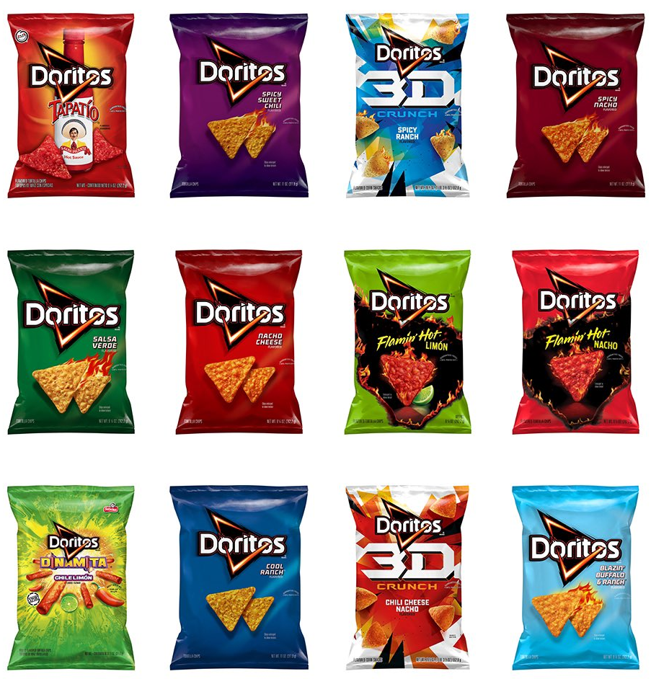
Line Extensions

Slide 5
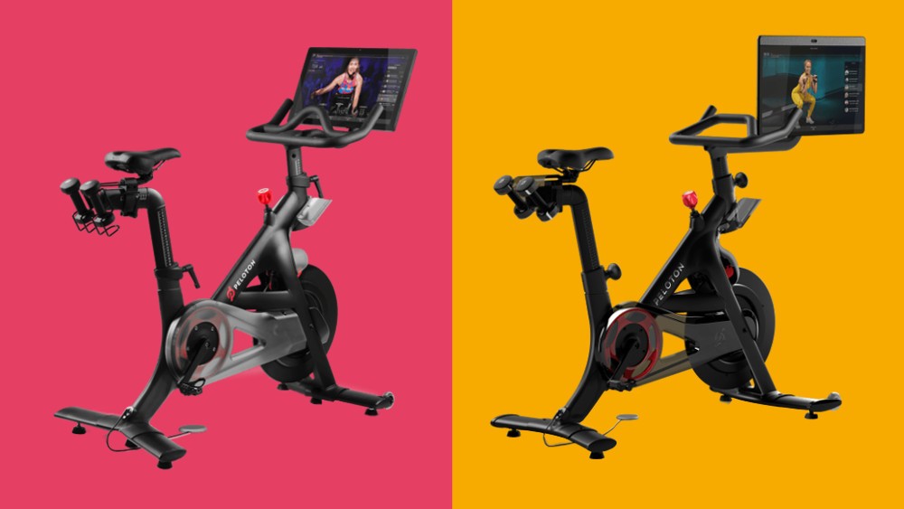
Peloton Bikes

Slide 6
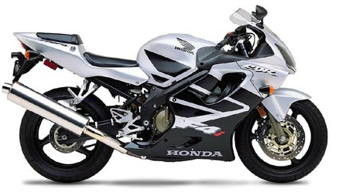
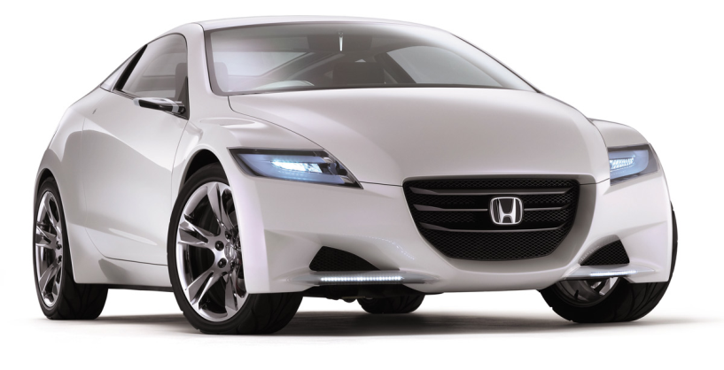
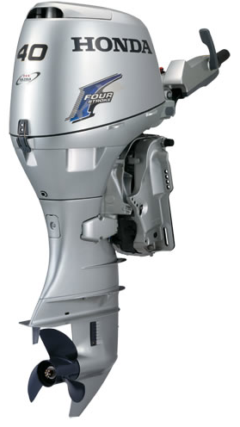

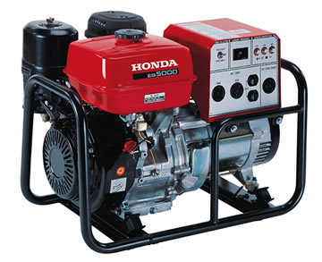
Category Extensions

Slide 7

Peloton Treads

Slide 8
More Common in Mature Markets
Market Stage
Growth Maturity
New Brand 73% 17%
Extension 27% 83%

Slide 9
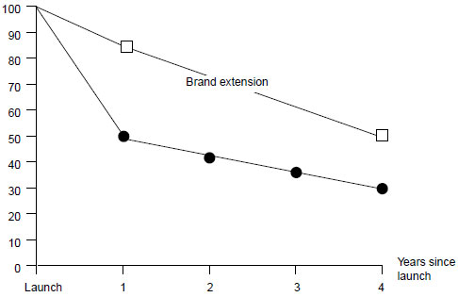
Relative Rate of Success of Brand Extensions versus New Brands

Slide 10
Greater Success in Mature Markets
Market Stage
Growth Maturity
New Brand 57% 43%
Extension 46% 68%

Slide 11
Brand Extension Advantages
Reduces consumer and company risk
Increases consumer trial and conversion
Reduces cost of product development
Reduces cost of launch
Greater channel receptivity
Greater promotion efficiency
Potential feedback effects on parent brand

Slide 12
Brand Extension Disadvantages
Failure may damage parent brand image
Cannibalization of parent brand
Brand dilution
Missed opportunity for new brand

Slide 13
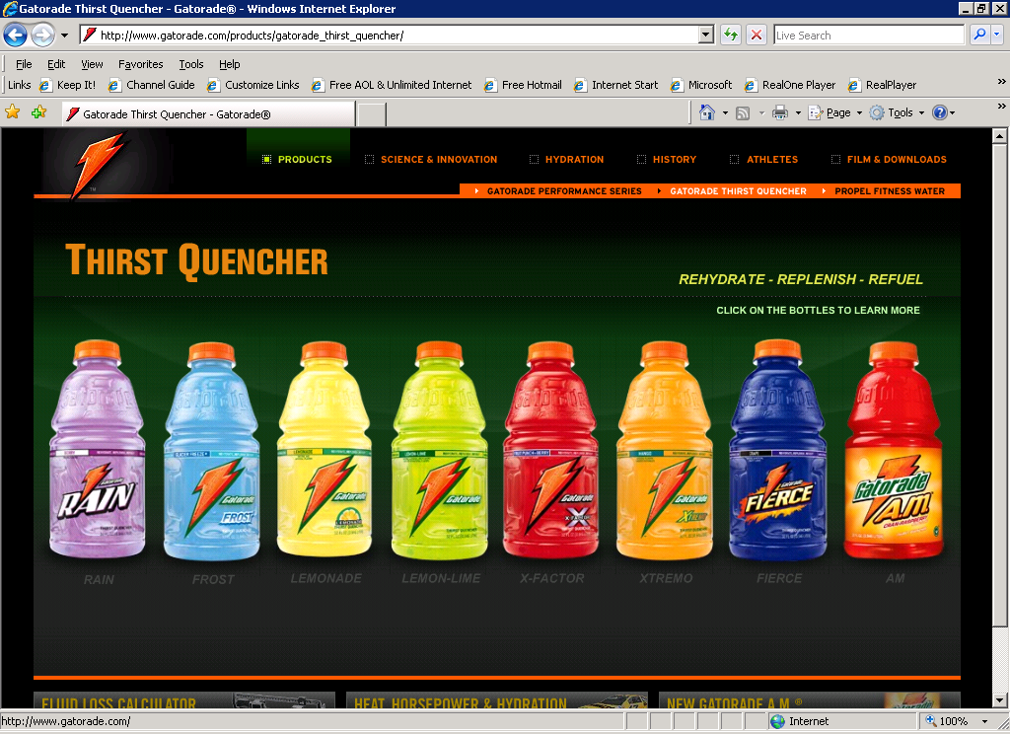
Too Many Gatorades?

Slide 14


















Could Have Been “P&G”…

Slide 15
Two Key Issues
Creating extension equity
Feedback (positive) to parent brand equity

Slide 16
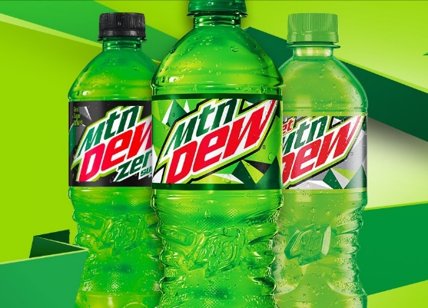
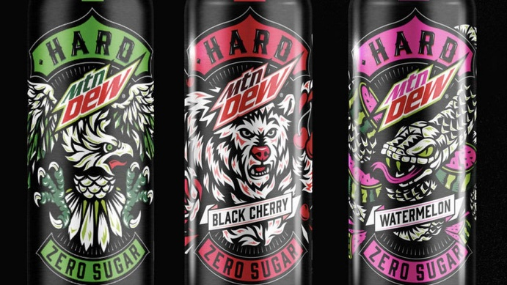
Brand Equity Feedback
“Parent”
“Extension”
t₁
Unique
Associations
Unique
Associations
Shared
EDGY
YOUTH
ADULT

Slide 17
Brand Equity Feedback (2)
“Parent”
“Extension”
Unique
Associations
Unique
Associations
Shared
ADULT
t₂
EDGY

Slide 18

Benefits of Positive Feedback Effect
Enhance parent brand image
Attract new customers to parent
Revitalize a “tired” brand
Enable further extensions

Slide 19
Risk Profile for Brand Extensions
Positive
Extension Impact on the Meaning of the Parent Brand
Negative
Moderate Risk: Consider Sub-branding
Low Risk: Use Branded House
High Risk: Use House of Brands
Moderate Risk: Consider Endorsed branding
Negative Positive
Parent Brand Impact on the Meaning of the Extension

Slide 20
Conclusion
As a consumer, do you respond favorably to brand extensions?
Can you think of any “over-extended” brands?

Slide 21
End of Lecture

